Slide 1

Salary Predictions

Slide 2
Contents
Business Problem
Key Takeaways
Dataset Information
Exploratory Data Analysis / EDA
Data Preprocessing and Feature Engineering
Modelling and Evaluation
Model Results
Next Steps

Slide 3
Business Problem
The problem addressed in this project entails how HR department can offer reasonable salary to staff and thereby be able to reduce unnecessary cost to the company while maintaining positive employee motivation.
If staff happens to be underpaid, there will be high employee dissatisfaction resulting in increased employee turnover within the company. While on the other hand, overpaying can increase company’s cost which could have been used to further the growth and expansion of the company.

Slide 4

Key Takeaways
‘Job Type’ and ‘Degree’ are found to have a high impact on the target variable, ‘Salary’
The respective roles were further grouped by ‘Job Type’, ‘Degree’, ‘Major’, ‘Industry’ resulting in few features
Consequently, it is seen that the ‘mean’ of each group has the highest impact on the ‘Salary’

Slide 5

Dataset Information
The Dataset comprises seven features which can help us determine the salary
‘Salary’ is the target variable we are predicting
Categorical Features
Job Id
Company Id
Job Type,
Degree,
Major
Industry
Numerical Features
Years of Experience
Miles for Metropolis
Salary

Slide 6

The best way to predict
the future is to create it”
Peter Drucker

Slide 7
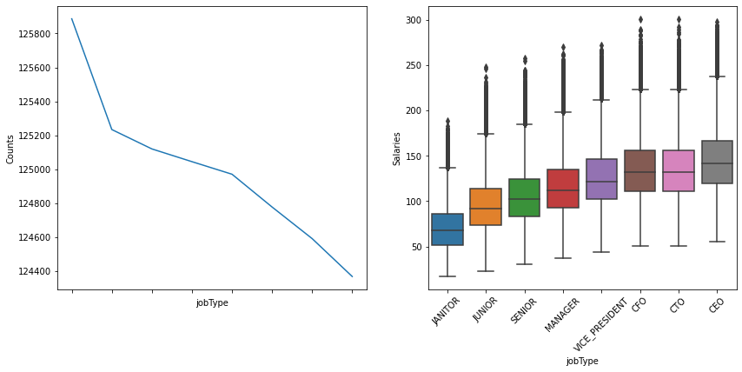
Exploratory Data Analysis /EDA
Relationship between Target Variable (Salaries) and Input Variables
Salary is positively correlated with job type

Slide 8
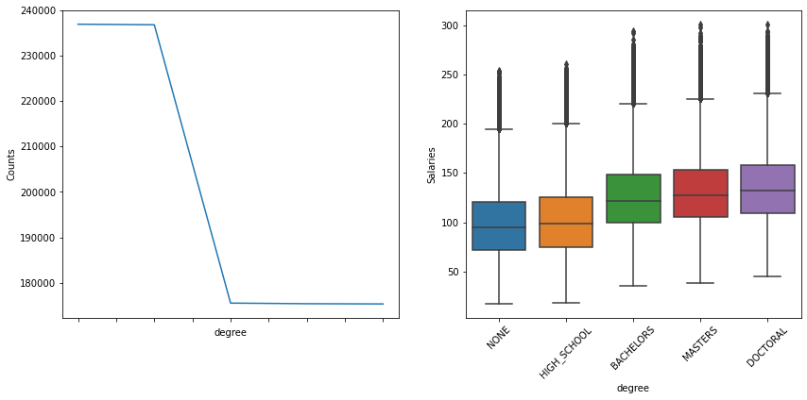
Exploratory Data Analysis /EDA
Relationship between Target Variable (Salaries) and Input Variables
High salaries tend to correspond to advanced degrees

Slide 9
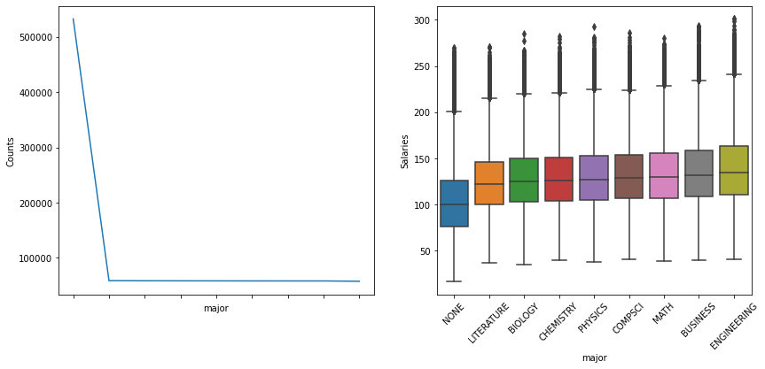
Exploratory Data Analysis /EDA
Relationship between Target Variable (Salaries) and Input Variables
Employees with majors of engineering, business and math have
corresponding high salaries

Slide 10
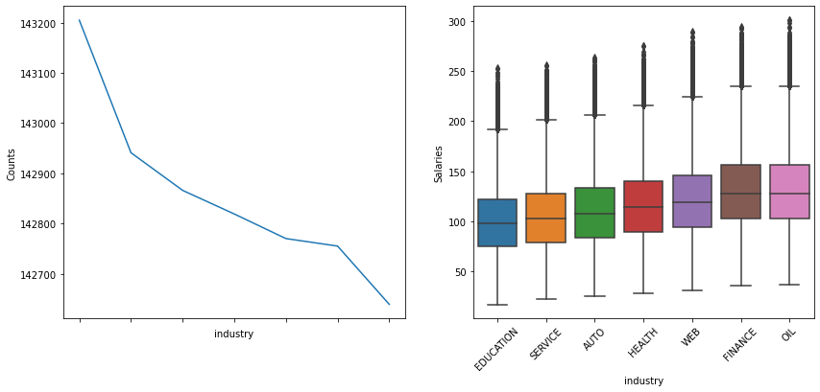
Exploratory Data Analysis /EDA
Relationship between Target Variable (Salaries) and Input Variables
Higher salaries correspond to the oil, finance and web industry sectors

Slide 11
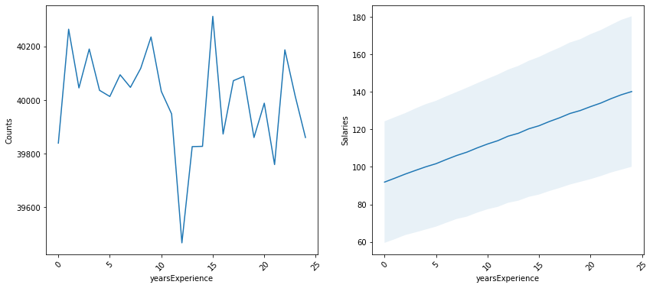
Exploratory Data Analysis /EDA
Relationship between Target Variable (Salaries) and Input Variables
Salary is directly correlated with years of experience

Slide 12
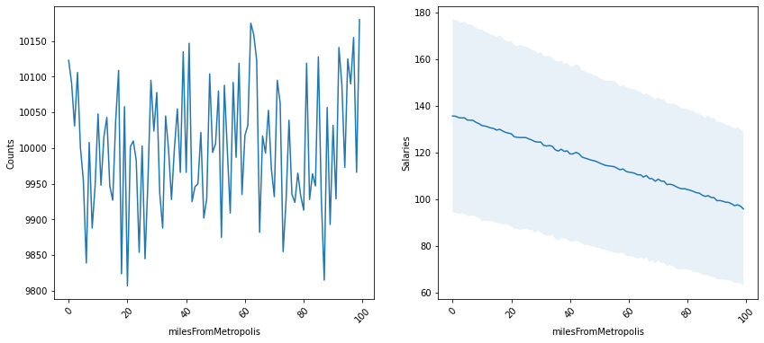
Exploratory Data Analysis /EDA
Relationship between Target Variable (Salaries) and Input Variables
Salaries decrease as you go further away from the metropolis

Slide 13
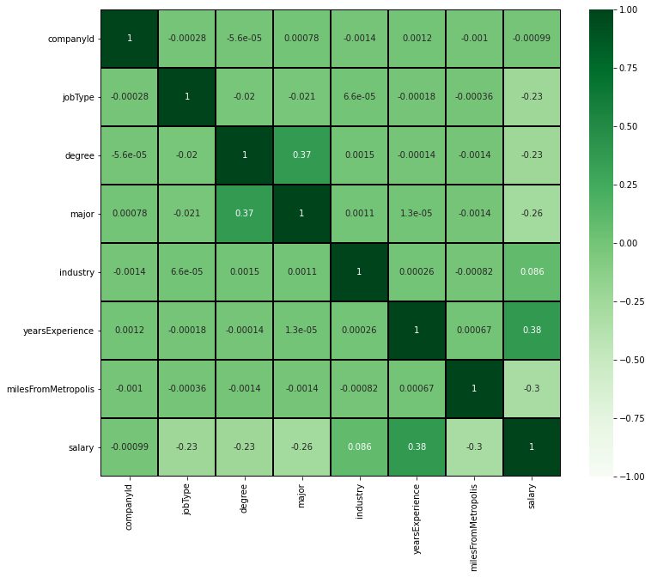
Exploratory Data Analysis /EDA
Visualizing the Correlation across all Columns

Slide 14
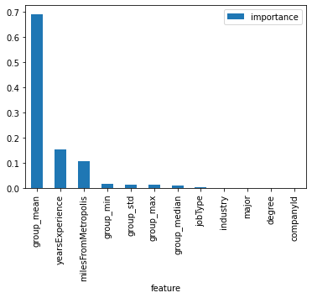
Data Preprocessing and Feature Engineering
Categorical features were grouped and new statistical features were calculated for the ‘Salary’ for each group
group_mean
group_std
group_max
group_min
group_median

Slide 15
Modelling and Evaluation
Supervised Machine Learning algorithms, namely, Regression and Ensembles of Regression Algorithms suit our data and efficacy goal.
Three models were chosen:
Linear Regression : sometimes simple is best
Random Forest Regressor : offers Improved accuracy and control over-fittings
Gradient Boosting Regressor : can optimize on Least squares regression.

Slide 16
Model Results
The Efficacy Metrics is :
Mean Square Error / MSE
Baseline Model : MSE 1499.00
Linear Regression : MSE 358.16
Random Forest Regressor : MSE 313.77
Gradient Boosting Regressor : MSE 313.14
Hence forth Gradient Boosting Regressor is chosen as the BEST MODEL

Slide 17
Next Steps
There is window of opportunity to further explore and improve the model by creating new features in relation to ‘miles from metropolis’ and ‘years of experience’ features.
File is saved appropriately for further testing / deployment.

Slide 18


